Slide 1
CSS

Slide 2
Browser’s Object Model
The collection of objects that the browser makes available to you for use with JavaScript is generally called the Browser Object Model (BOM).
The BOM has a hierarchy. At the very top of this hierarchy is the window object. You can think of this as representing the frame of the browser and everything associated with it, such as the scrollbars, navigator bar icons, and so on.Contained inside the window frame is the page. The page is represented in the BOM by the documen objectt.

Slide 3
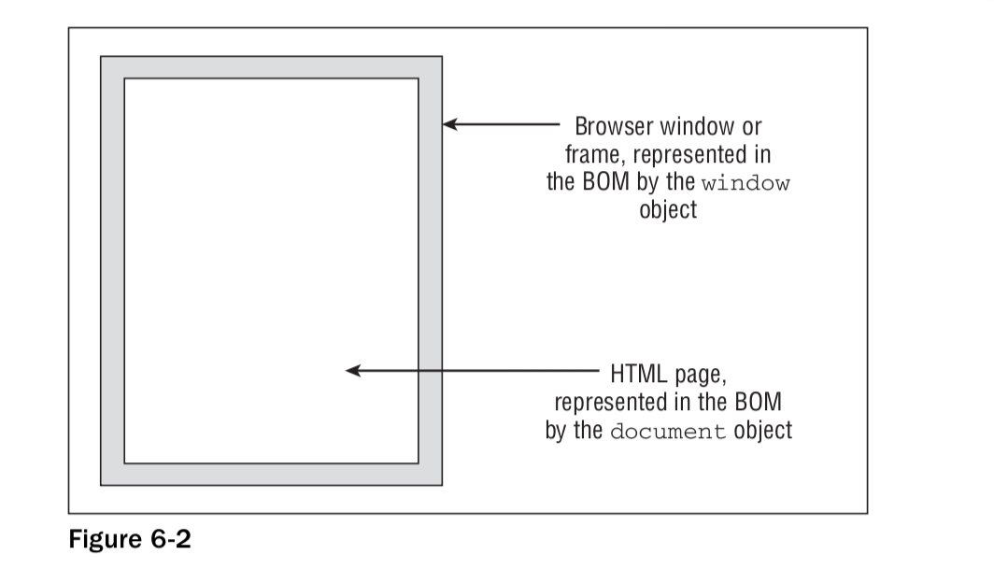
You can see these two objects

Slide 4
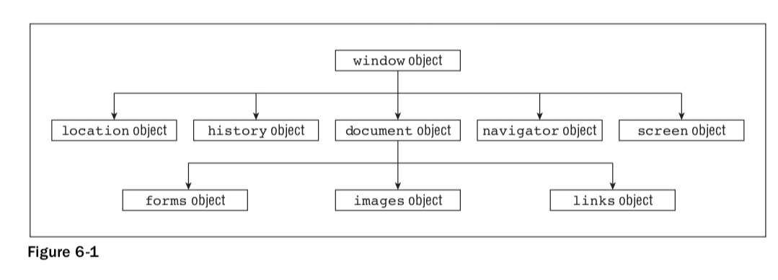
Object Hierarchy:

Slide 5
The window Object
The window object represents the browser’s frame or window, in which your web page is contained.
For example, via the properties of the window object, you can fi nd out what browser is running, the pages the user has visited, the size of the browser window, the size of the user’s screen, and much more.
The window object is a global object, which means you don’t need to use its name to access its properties and methods.
For example, the alert() function you have been using since the beginning of the book is, in fact, the alert() method of the window object. Although you have been using this simply as this:
alert(“Hello!”);
You could write this with the same, exact results:
window.alert(“Hello!”);
However, since the window object is the global object, it is perfectly correct to use the fi rst version.

Slide 6
To change the default message in the window’s status bar, you need to use the window object’s
defaultStatus property. To do this, you can write the following:
window.defaultStatus = “Hello and Welcome”;
Or, because the window is the global object, you can just write this:
defaultStatus = “Hello and Welcome”;

Slide 7
The history Object
The history object keeps track of each page that the user visits.
This list of pages is commonly called the history stack for the browser. It enables the user to click the browser’s Back and Forward buttons to revisit pages. You have access to this object via the window object’s history property.
Like the native JavaScript Array type, the history object has a length property. You can use this to fi nd out how many pages are in the history stack.
As you might expect, the history object has the back() and forward() methods. When they are called, the location of the page currently loaded in the browser is changed to the previous or next page that the user visit.

Slide 8
The history object also has the go() method. This takes one parameter that specifi es how far forward or backward in the history stack you want to go. For example, if you wanted to return the user to the page before the previous page, you’d write this:
history.go(-2);
To go forward three pages, you’d write this:
history.go(3);.
Note that go(-1) and back() are equivalent, as are go(1) and forward()

Slide 9
The Location Object
The location object contains lots of potentially useful information about the current page’s location.
Not only does it contain the Uniform Resource Locator (URL) for the page, but also the server hosting the page, the port number of the server connection, and the protocol used. This information is made available through the location object’s href, hostname, port, and protocol properties.
In addition to retrieving the current page’s location, you can use the methods of the location object to change the location and refresh the current page.
For example, to replace the current page with a new page called myPage.htm, you’d use the replace() method and write the following:
window.location.replace(“myPage.htm”);

Slide 10
The navigator object
The navigator object is another object that is a property of window and is available in all browsers.
Its name is more historical than descriptive. Perhaps a better name would be the “browser object,” because the navigator object contains lots of information about the browser and the operating system in which it’s running.
Probably the most common use of the navigator object is for handling browser differences. Using its properties, you can fi nd out which browser, version, and operating system the user has.

Slide 11
The screen Object
The screen object property of the window object contains a lot of information about the display capabilities of the client machine. Its properties include the height and width properties, which indicate the vertical and horizontal range of the screen, respectively, in pixels.
Another property of the screen object, which you will be using in an example later, is the colorDept property.
This tells you the number of bits used for colors on the client’s screen.

Slide 12
The document Object
Along with the window object, the document object is probably one of the most important and commonly used objects in the BOM. Via this object you can gain access to the HTML elements, their properties and methods inside your page.
The document object has a number of properties associated with it, which are also array-like structures called collections.
The main collections are the forms, images, and links collections.

Slide 13
JavaScript Properties
Properties are the values associated with a JavaScript object.
A JavaScript object is a collection of unordered properties.
Properties can usually be changed, added, and deleted, but some are read only.
Accessing JavaScript Properties
The syntax for accessing the property of an object is:
objectName.property // person.age
Or
objectName["property"] // person["age"]
or
objectName[expression] // x = "age"; person[x]

Slide 14
Adding New Properties
You can add new properties to an existing object by simply giving it a value.
Assume that the person object already exists - you can then give it new propertY.
Deleting Properties
The delete keyword deletes a property from an object:
The delete keyword deletes both the value of the property and the property itself.
After deletion, the property cannot be used before it is added back again.
The delete operator is designed to be used on object properties. It has no effect on variables or functions.

Slide 15
Objects can be initialized using new Object(), Object.create(), or using the literal notation (initializer notation). An object initializer is a comma-delimited list of zero or more pairs of property names and associated values of an object, enclosed in curly braces ({}).

Slide 16
Getters and setters are used to protect your data, particularly when creating classes. For each instance variable, a getter method returns its value while a setter method sets or updates its value. Given this, getters and setters are also known as accessors and mutators, respectively.

Slide 17
What Are Events?
Events occur when something in particular happens. For example, the user clicking on the page, clicking
on a hyperlink, or moving the mouse pointer over some text all cause events to occur. Another example,
which is used quite frequently, is the load event for the page: the window raises (or fi res) a notifi cation
when the page is completely loaded in the browser.

Slide 18
<body>
<a href=”somepage.htm” name=”linkSomePage”>
Click Me
</a>

